Slide 1
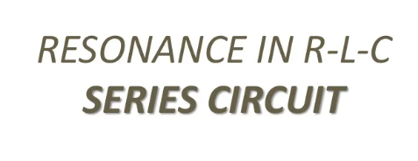

Slide 2
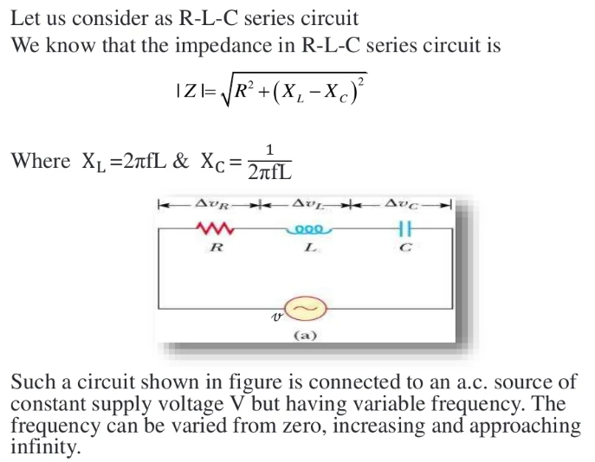
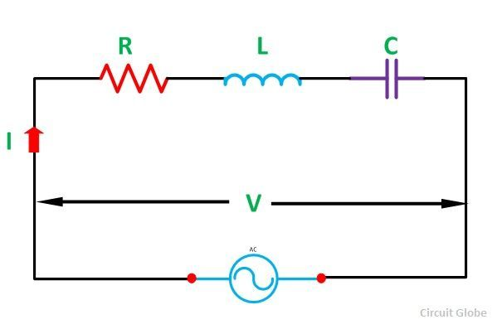

Slide 3
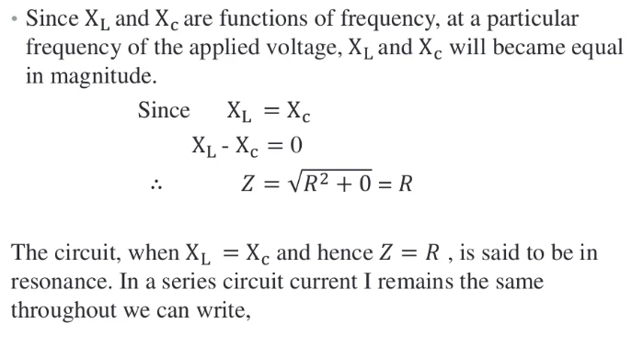

Slide 4
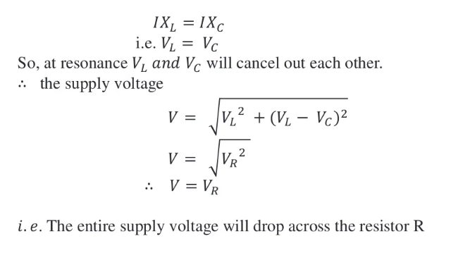

Slide 5
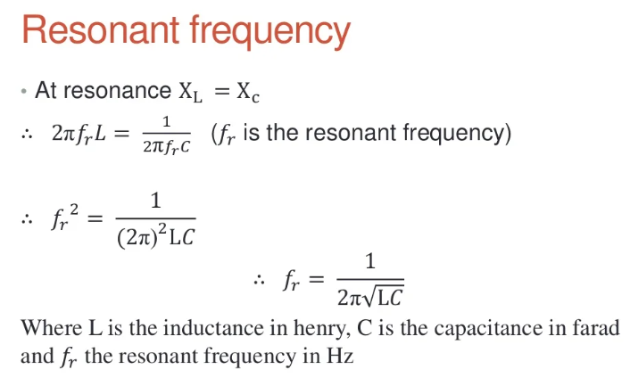

Slide 6
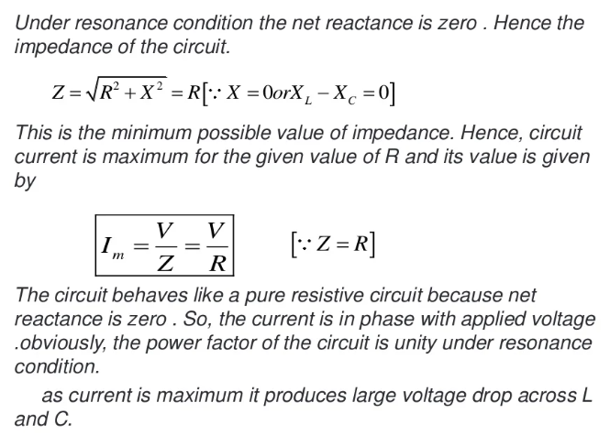

Slide 7
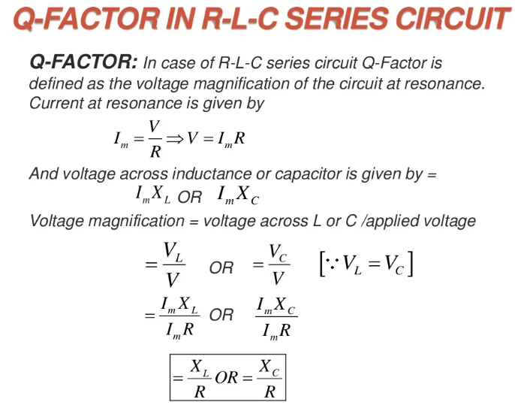

Slide 8
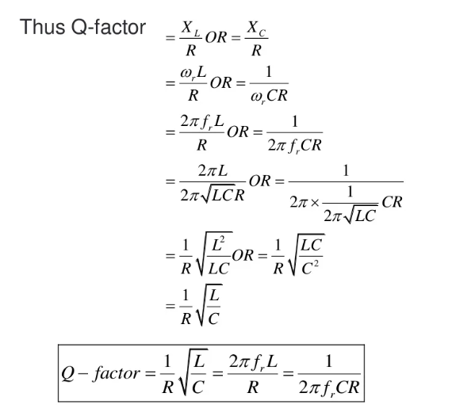

Slide 9
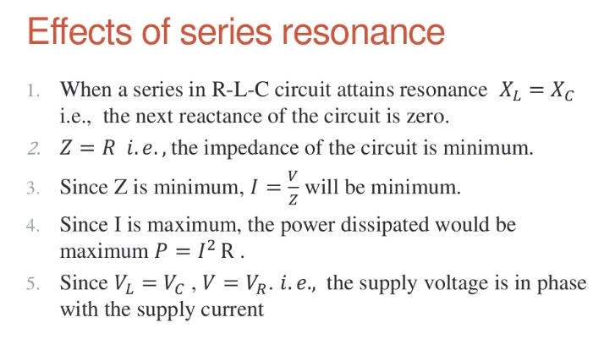

Slide 10
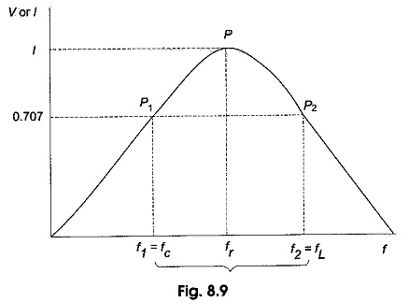
The bandwidth of RLC Circuit:
The bandwidth of any system is the range of frequencies for which the current or output voltage is equal to 70.7% of its value at the resonant frequency, and it is denoted by BW.

Slide 11
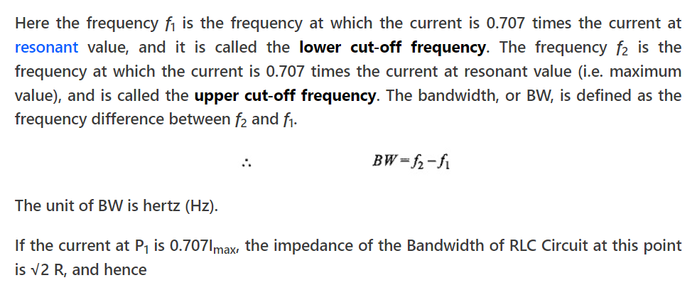

Slide 12
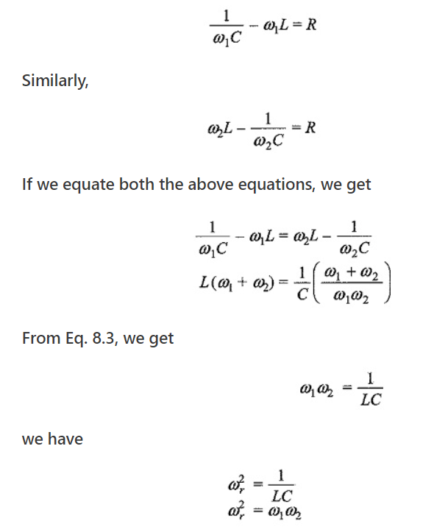

Slide 13
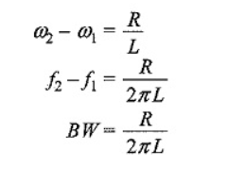
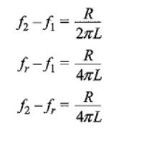

Slide 14
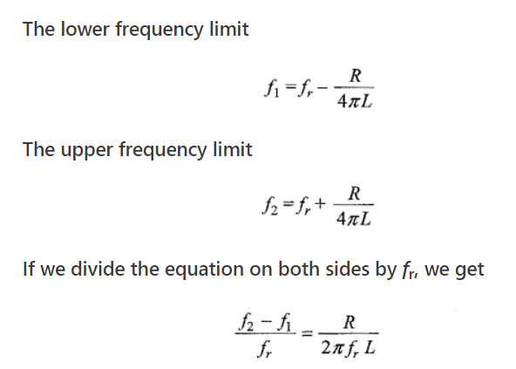

Slide 15
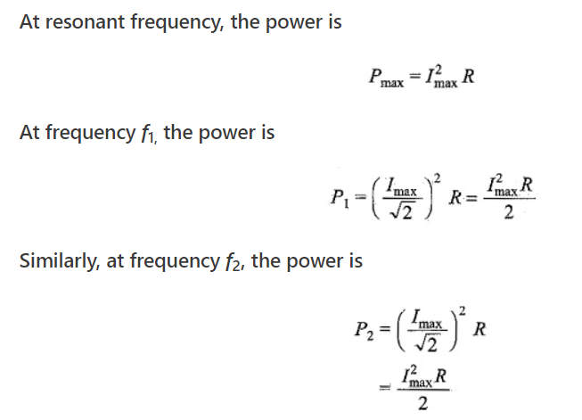
The upper and lower cut-off frequencies are sometimes called the half-power frequencies. At these frequencies the power from the source is half of the power delivered at the resonant frequency.

Slide 16
A 240 V, 50 Hz AC supply is applied a coil of 0.08 H inductance and 4 Ω resistance connected in series with a capacitor of 8 μF. Calculate the following −
Impedance,
Circuit current,
Phase angle between voltage and current,
Power factor,
Power consumed,
Q-factor of the circuit at resonant frequency.

Slide 17
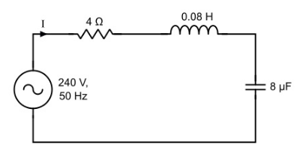

Slide 18
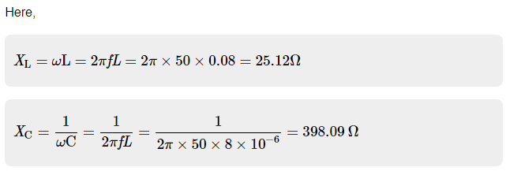
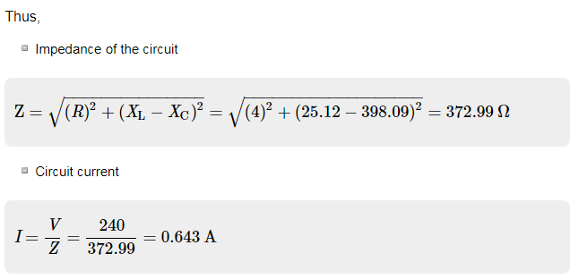

Slide 19
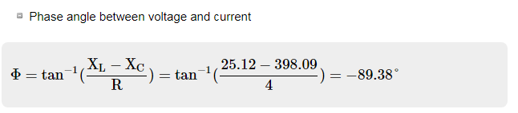
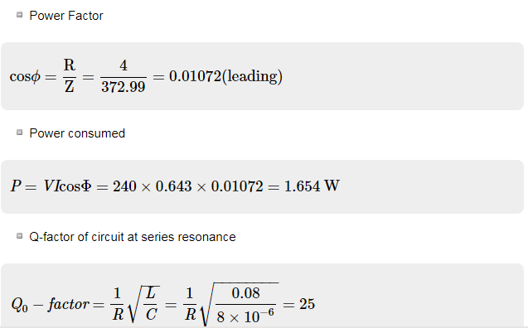

Slide 20
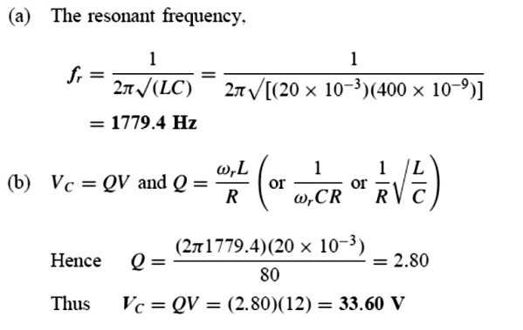
1- A series L–R–C circuit has a sinusoidal input voltage of maximum value 12 V. If inductance, L = 20 mH, resistance, R = 80 Ω, and capacitance, C = 400 nF, determine a. Inductive Reactance, b. Capacitive Reactance, c. Total Impedance, d. the resonant frequency, e. the value of the p.d. across the capacitor at the resonant frequency.
d.

Slide 21
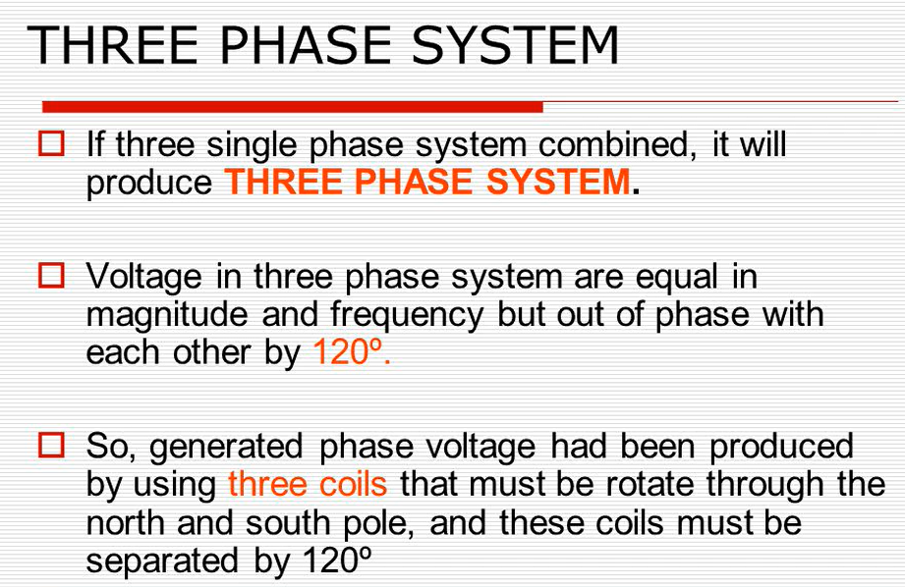

Slide 22
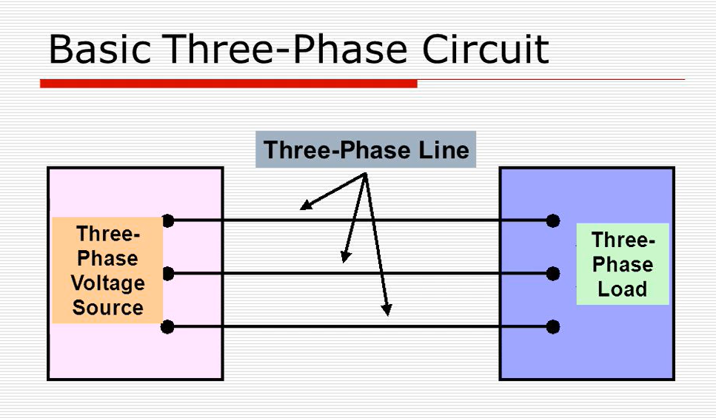

Slide 23
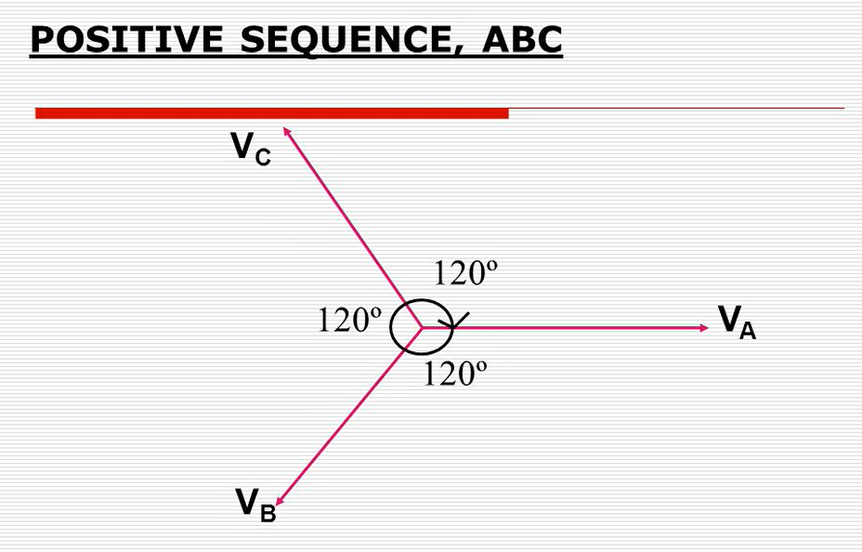

Slide 24
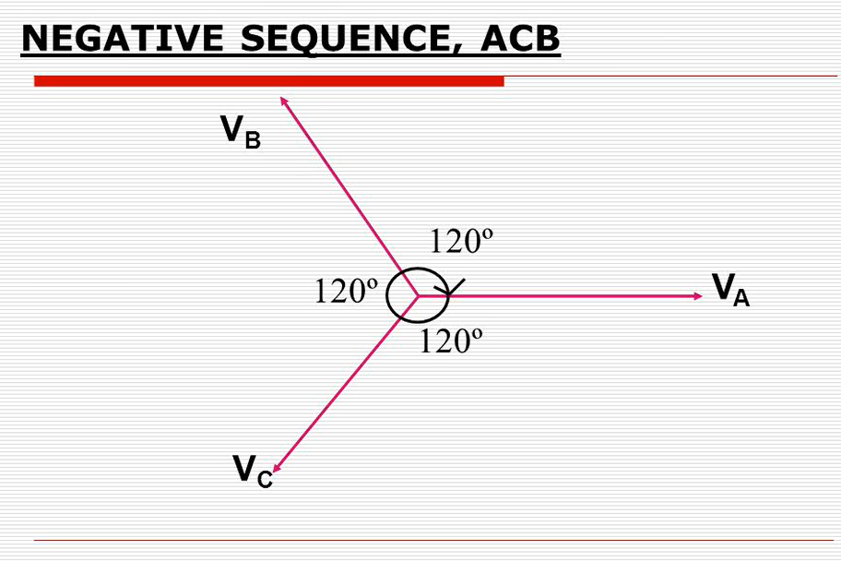

Slide 25
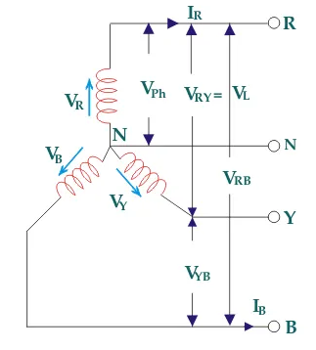
STAR CONNECTION

Slide 26

In the star connection, line current is same as phase current. The magnitude of this current is same in all three phases and say it is I_{L}.
I_{R} = I_{Y} = I_{B} = I_{L}, Where, I_{R} is line current of R phase, I_{Y} is line current of Y phase and I_{B} is line current of B phase. Again, phase current, I_{ph} of each phase is same as line current I_{L} in star connected system. ∴ I_{R} = I_{Y} = I_{B} = I_{L} = I_{ph}.
Thus, for the star-connected system line voltage = √3 × phase voltage. Line current = Phase current

Slide 27
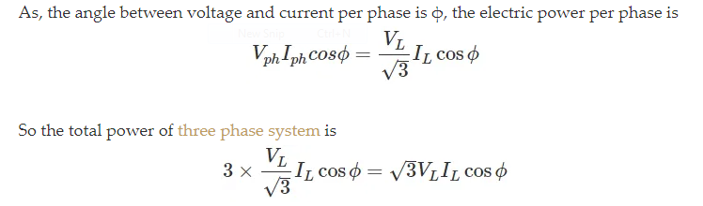

Slide 28
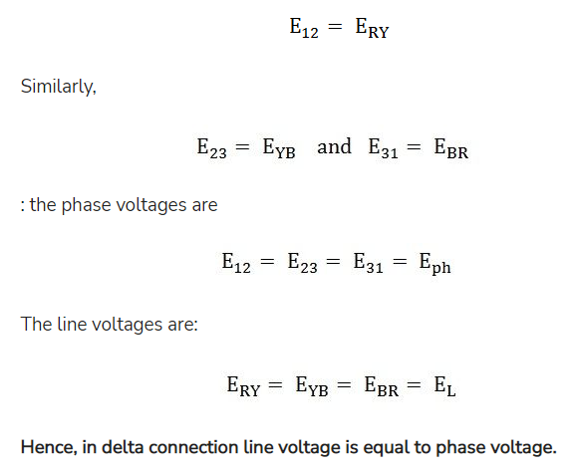
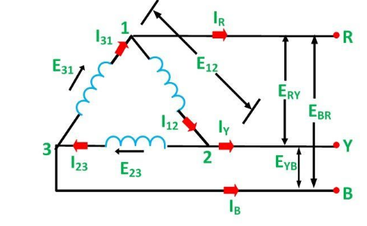

DELTA CONNECTION

Slide 29
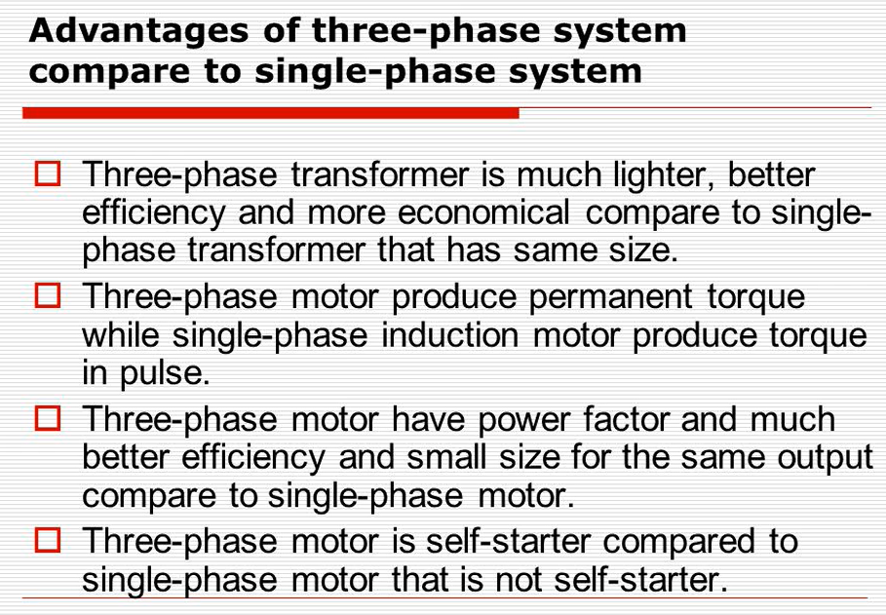
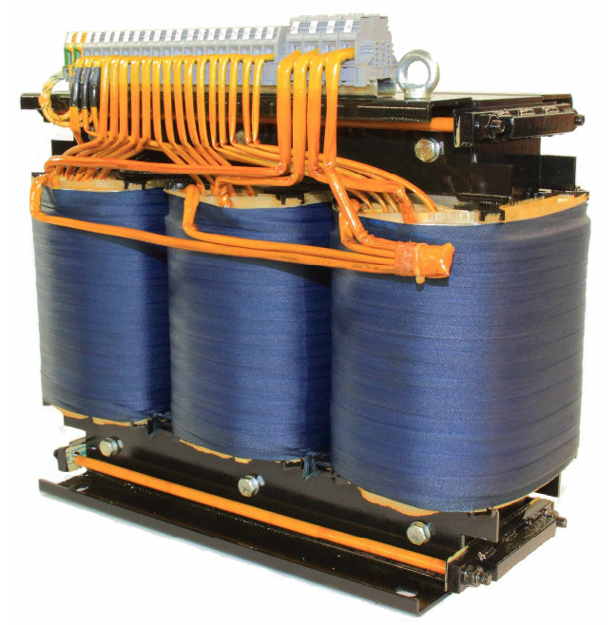
It is lighter and smaller. It requires less space to install. Low cost compared with three units of single phase transformers. Transportation is easy and also transportation cost is less.

Slide 30
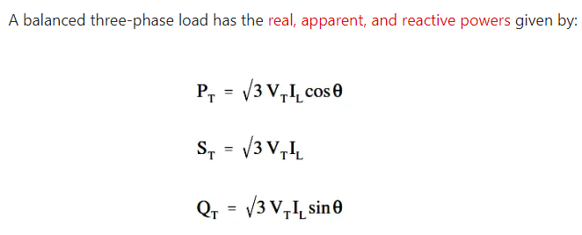

Slide 31
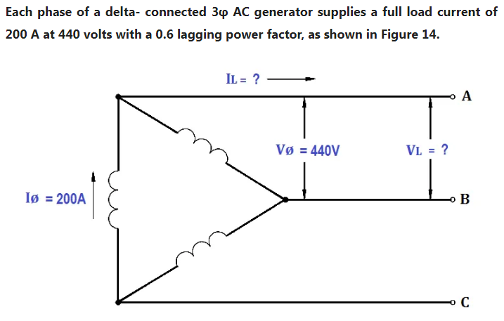
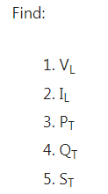

Slide 32
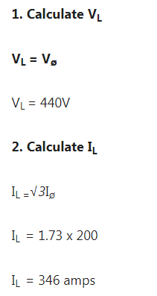
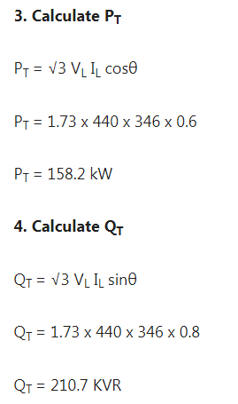
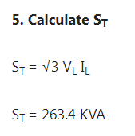

Slide 33
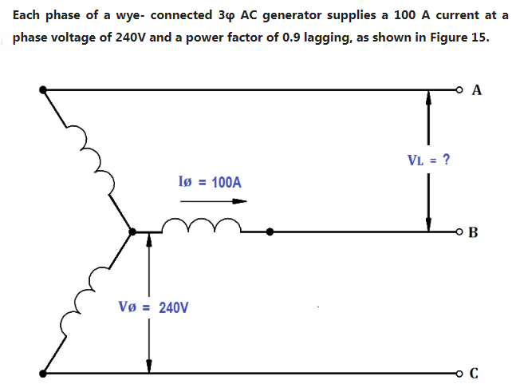
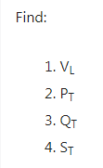

Slide 34
